Slide 1
Marxist and Feminist
Aim: to be able to explain the Marxist and Feminist approach to the study of families and family life.

Slide 2
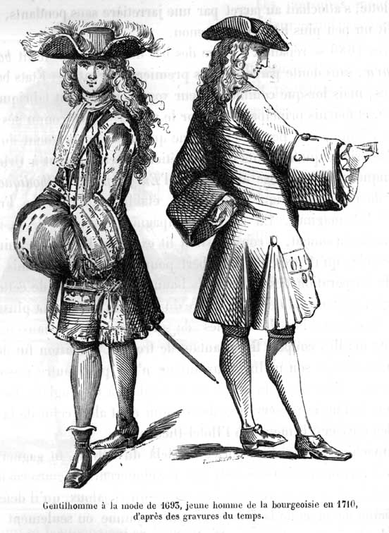
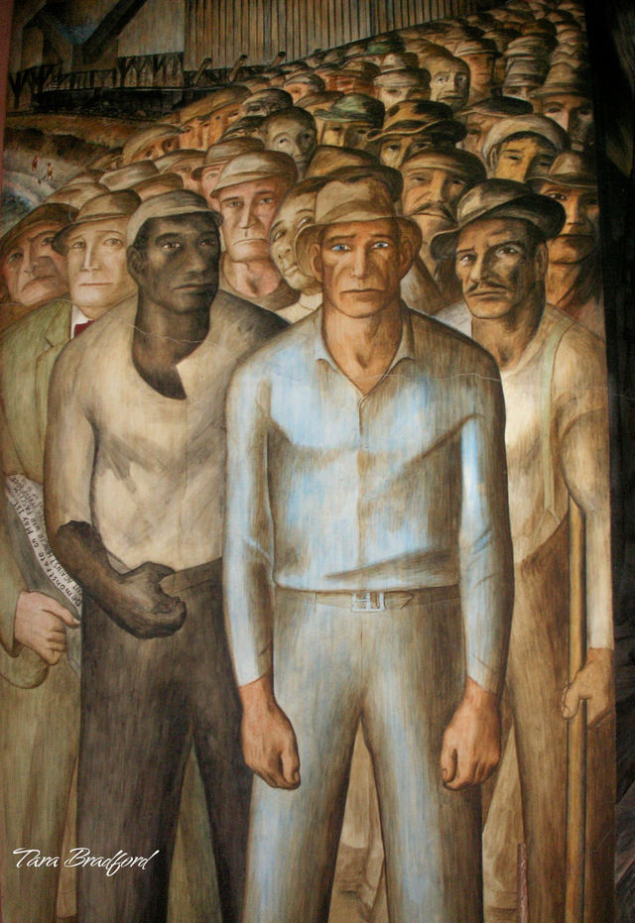
Marxist
Critical of the family and the role it plays in society
Capitalist societies are based on conflict between two social classes: the bourgeoisie (the people who own the big businesses) and the proletariat (the working class)

Slide 3
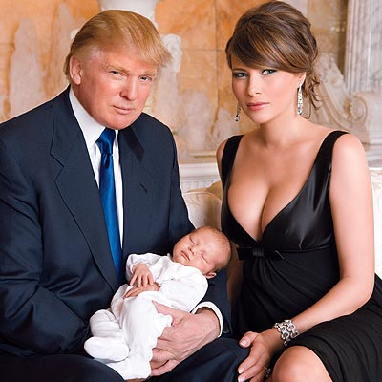

Criticism
The set up of the nuclear family enables social inequalities to continue from one generation to another
For example: the rich are able to pass on huge amounts of money and property to their family members .
Working class people may learn to accept their lower position in an unequal society

Slide 4
Feminist
Negative impact on the lives of women
Many differences between men and women are socially constructed (they are created by society)
Families contribute to this through the primary socialization process (ways in which boys & girls are dressed and the toys they are given)

Slide 5


Boys

Slide 6


Girls

Slide 7
Criticisms from Feminists
Families are patriarchal (based around the male power and dominance over women)
Jessie Bernard (1982) suggested that men needed marriage more then women. The mental health of men was far better than that of men who had never married
Why do you think this is??

